Slide 1
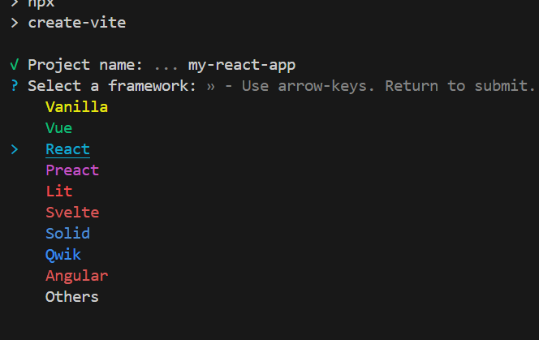
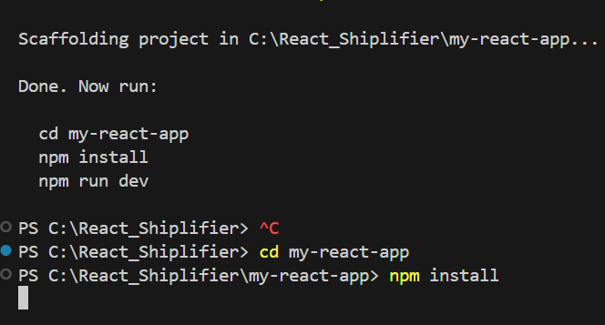
start React Project
npm create vite@latest
vite- development server
cd my-react-app
npm install
npm run dev---- to restart the server ng serve for angular

Slide 2
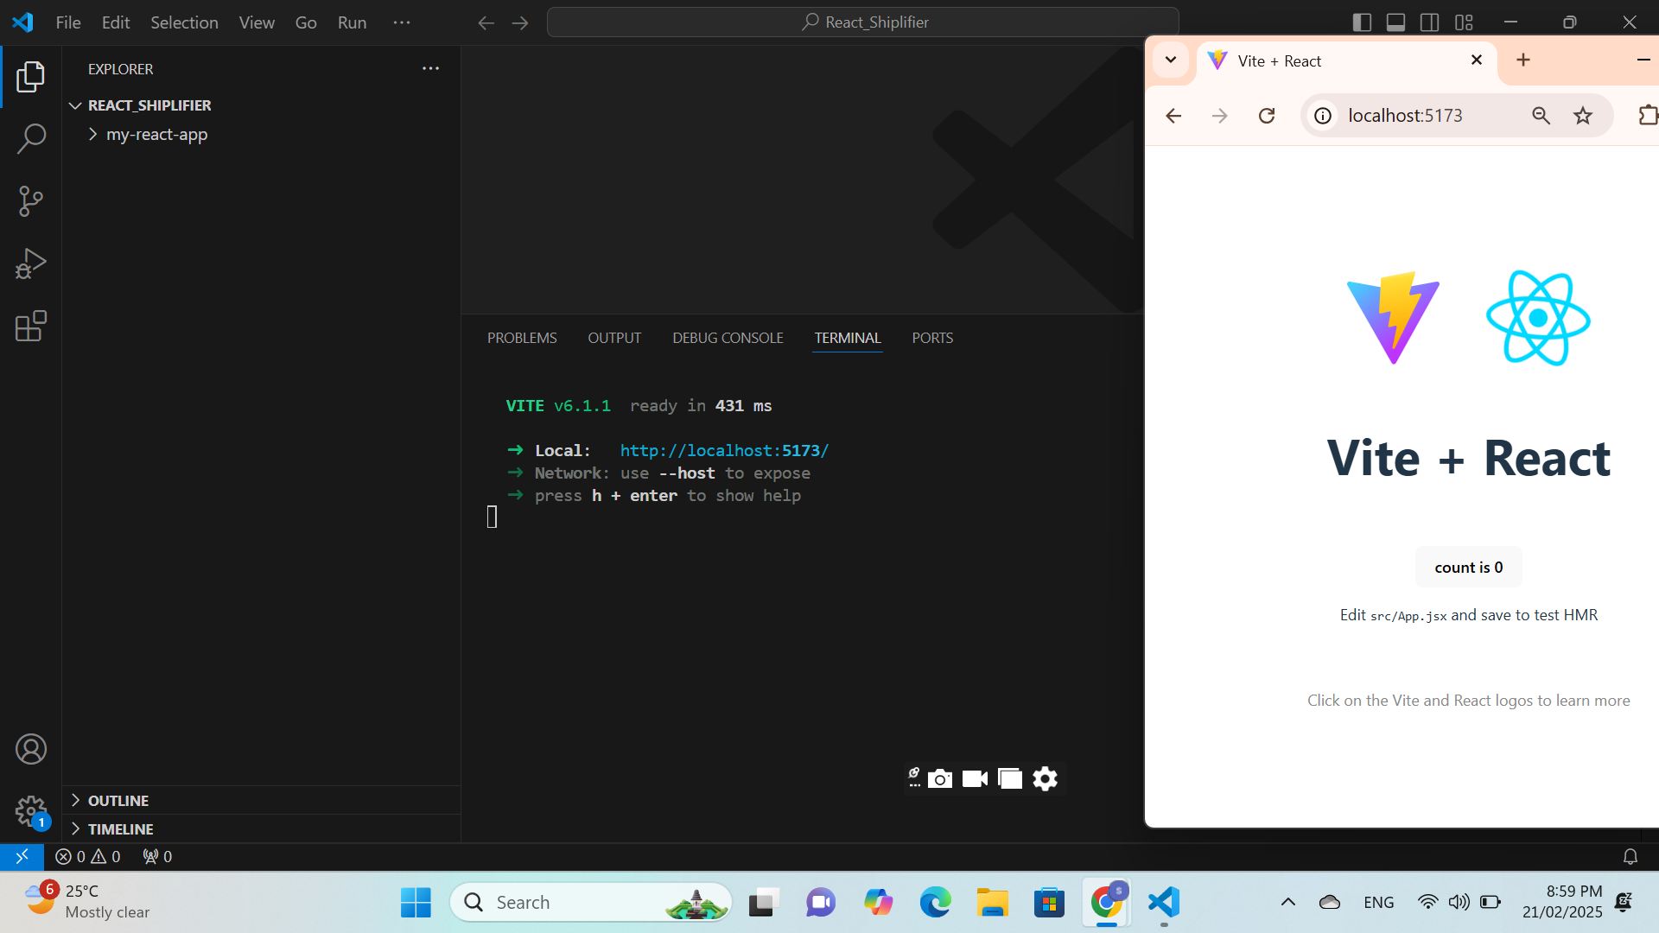

Slide 3
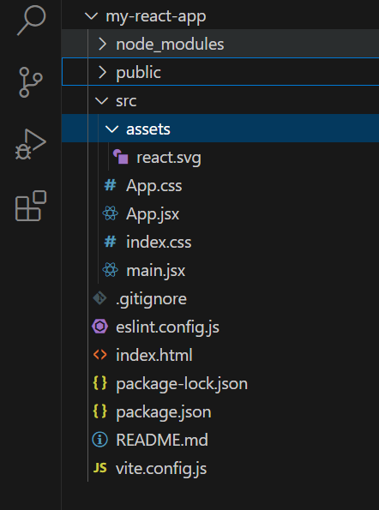
Folders inf
 | public--images,etc | NOT bundled during final output public\vite.svg src src\assets--images,etc| bundled during final output src\assets\react.svg src\App.css src\App.jsx src\index.css src\main.jsx components are added here like app component .gitignore eslint.config.js index.html package-lock.json package.json README.md vite.config.js

Slide 4
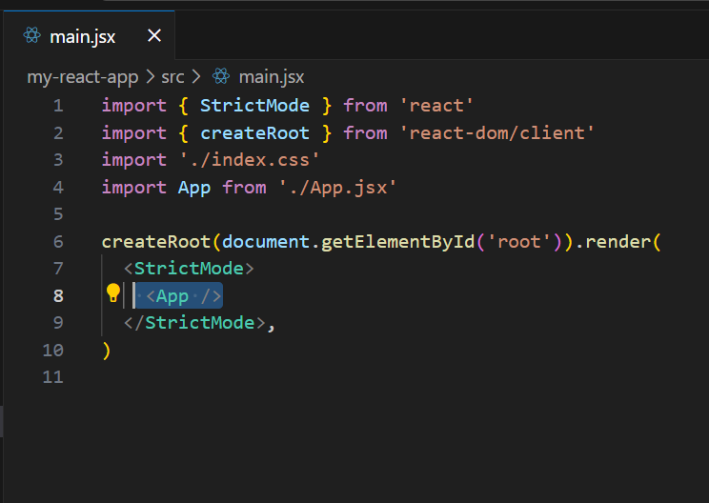
main
 | we are adding an app component jsx javascriptXML file

Slide 5
HOW TO ADD A COMPONENT

Slide 6
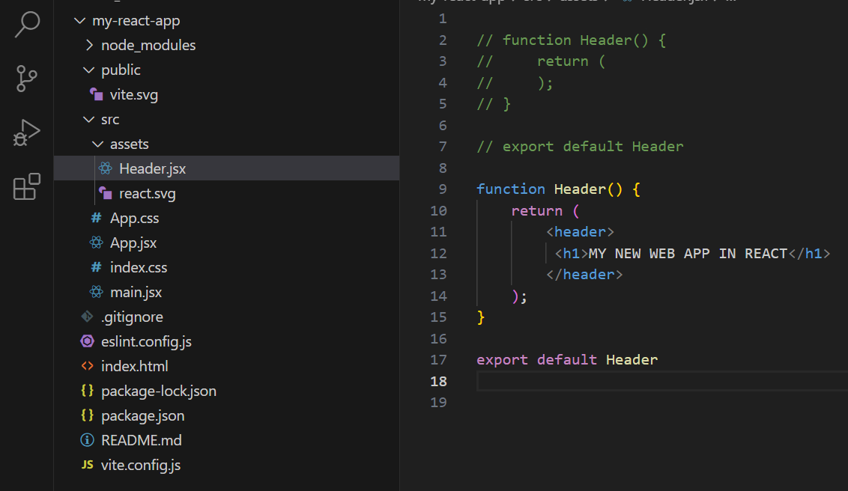
Header.jsx added
 | added a new file Header.jsx REact Compoent can return one element but that element can have children elemnt

Slide 7
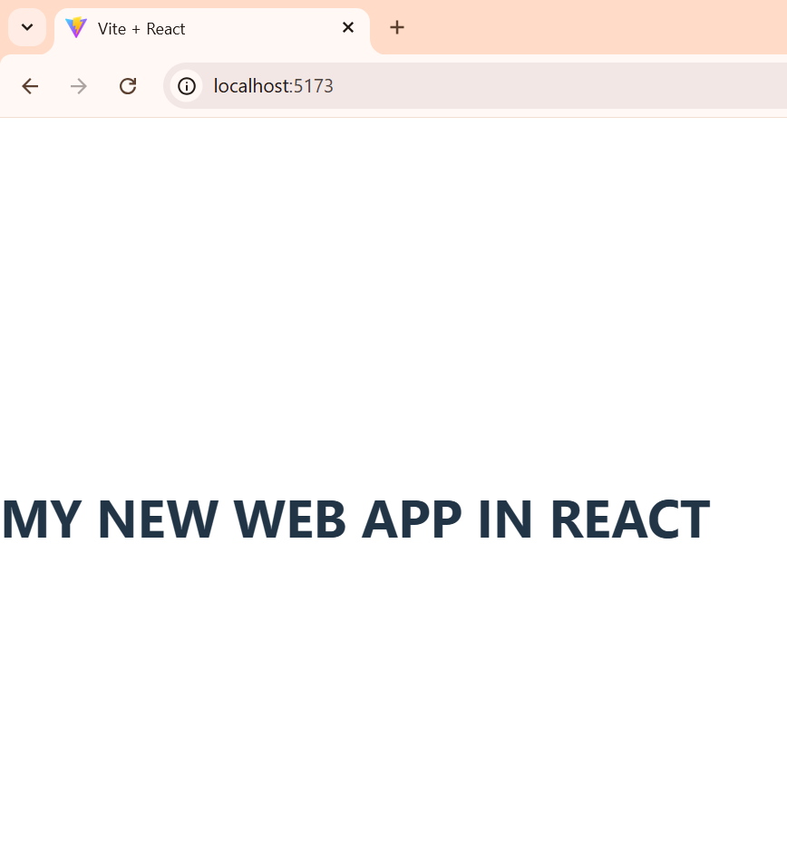
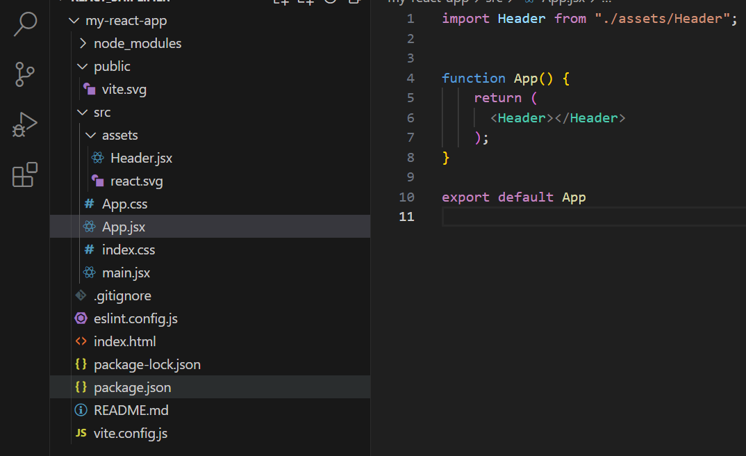
<Header>tag added
 | OUTPUT

Slide 8
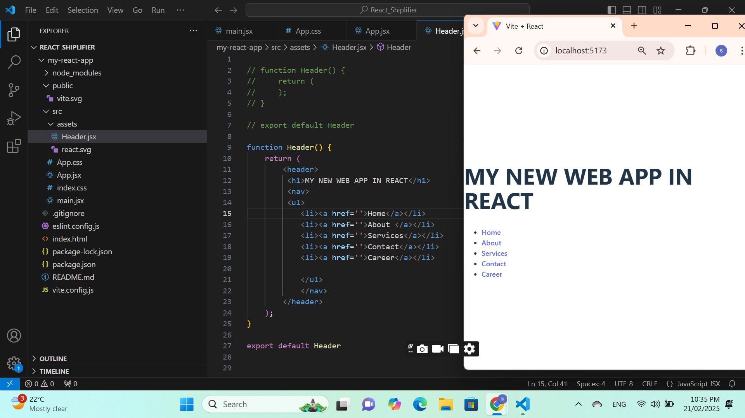
ADD FEW MORE ELEMENTS

Slide 9
ADD FEW MORE ELEMENTS

Slide 10
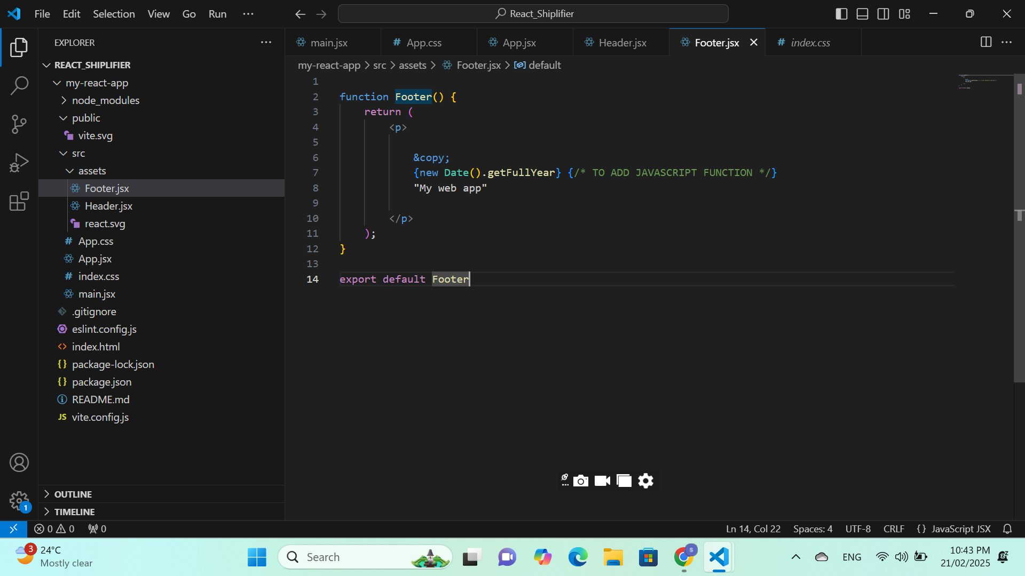
ADD FOOTER “{}” to add javascript code

Slide 11
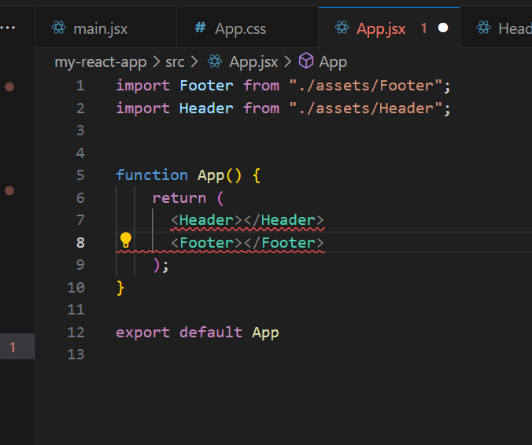
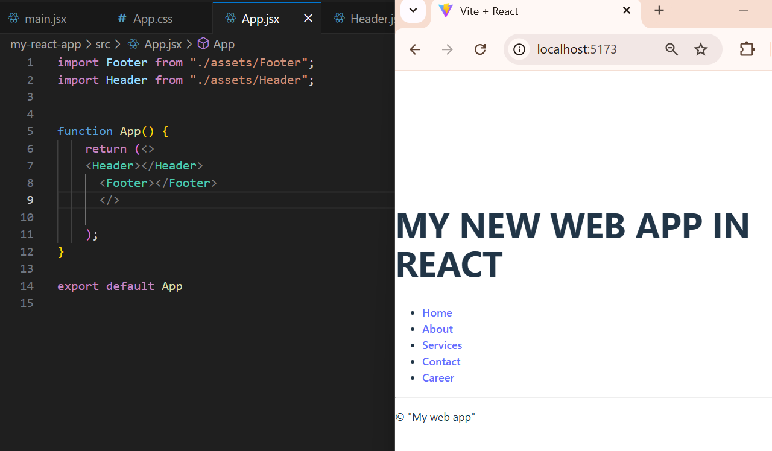
React component returns one so add <>fragment</>

Slide 12
When adding css in index.css then it is styling react component EXTERNAL

Slide 13
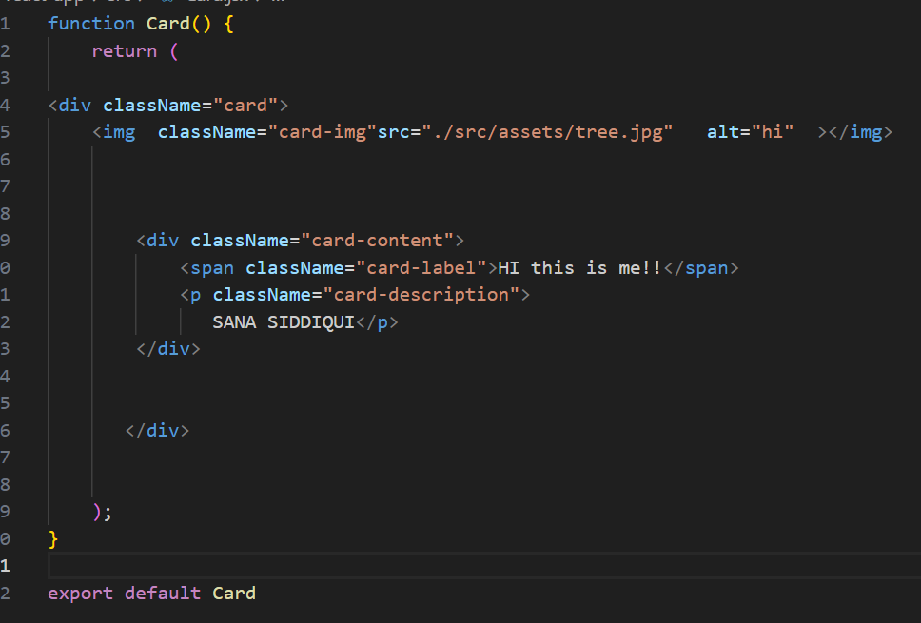
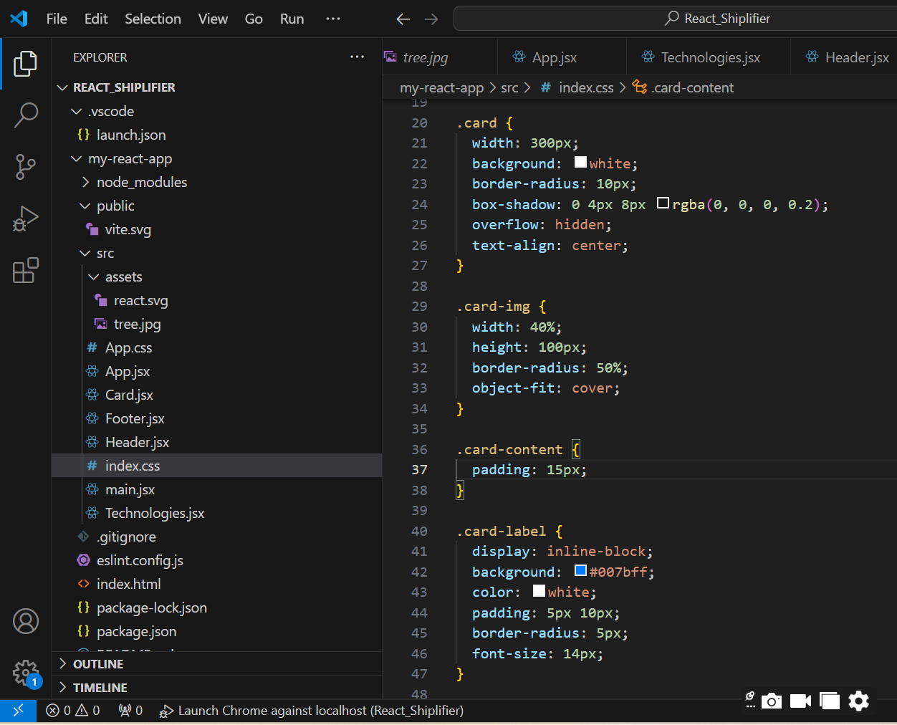
adding card

Slide 14
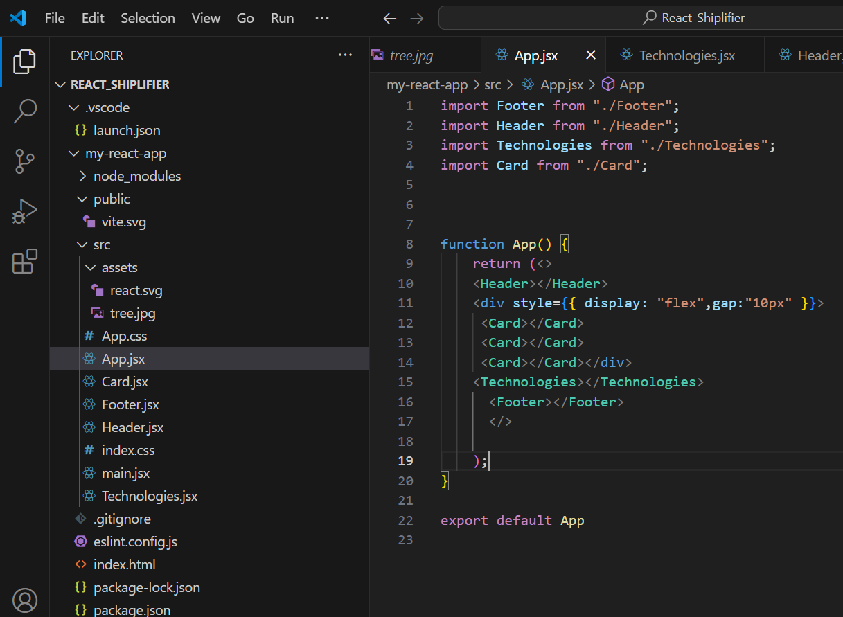
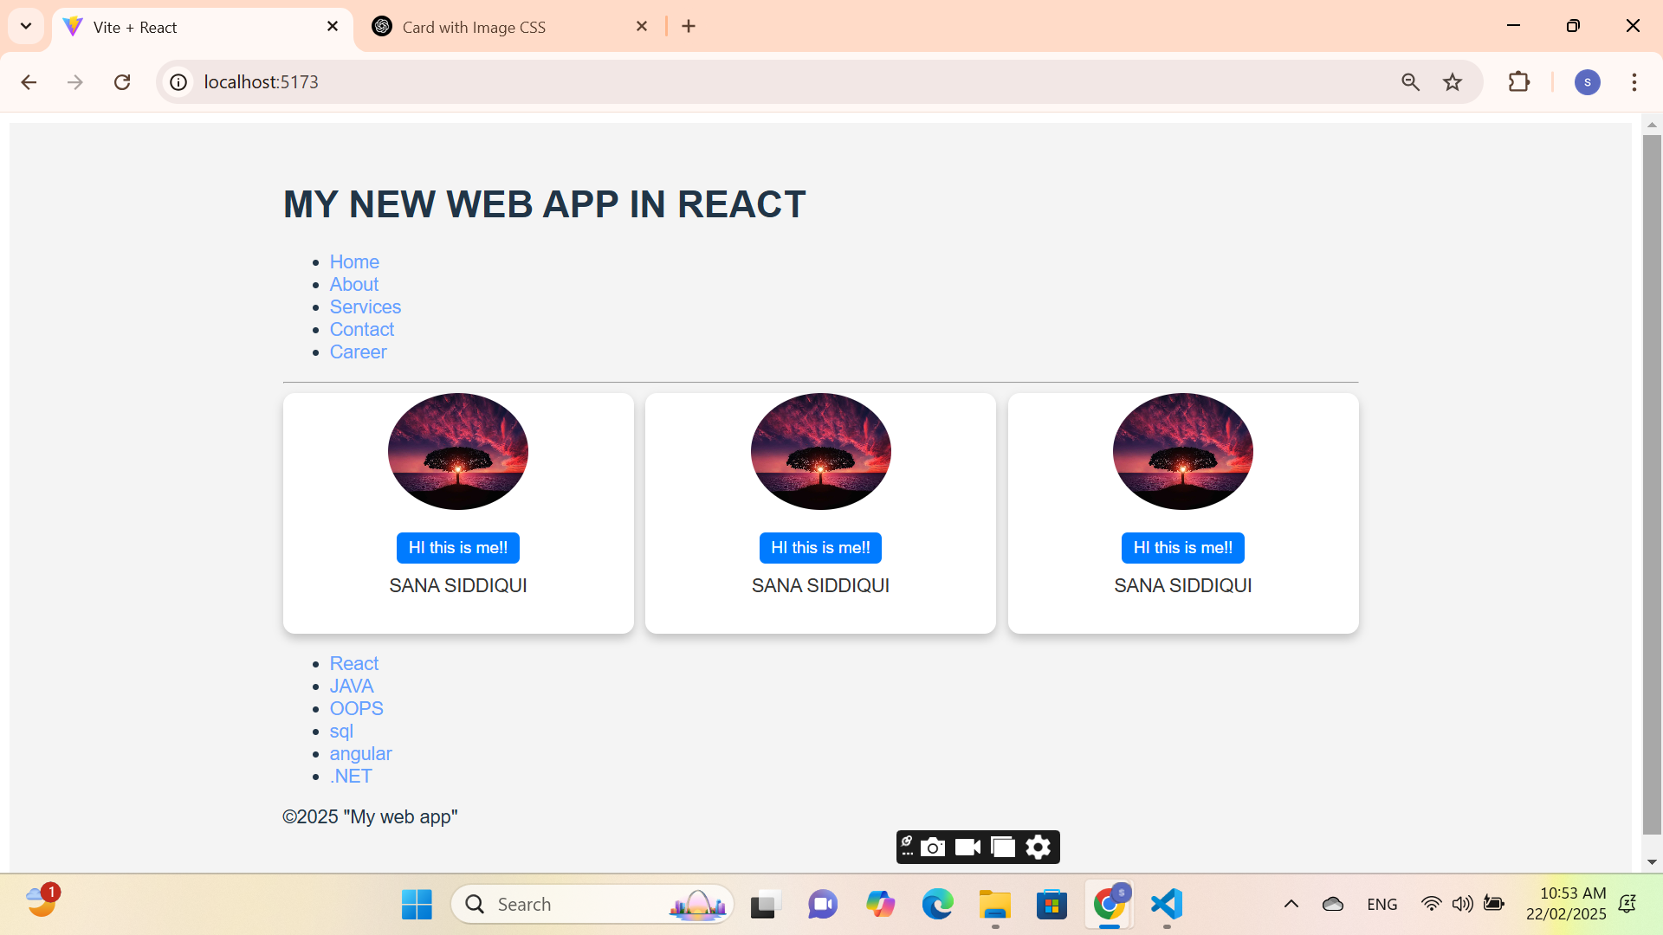
contd..

Slide 15
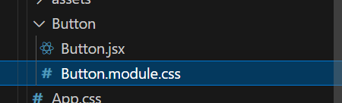
When adding css in specific css file
then it is styling react component MODULE

Slide 16
HOW TO ADD A MODULES

Slide 17
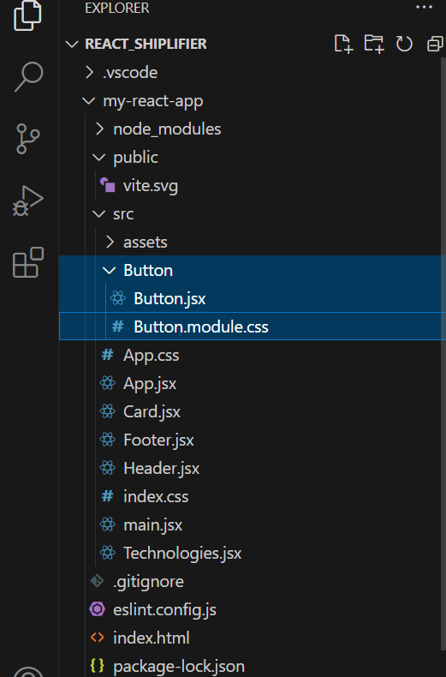
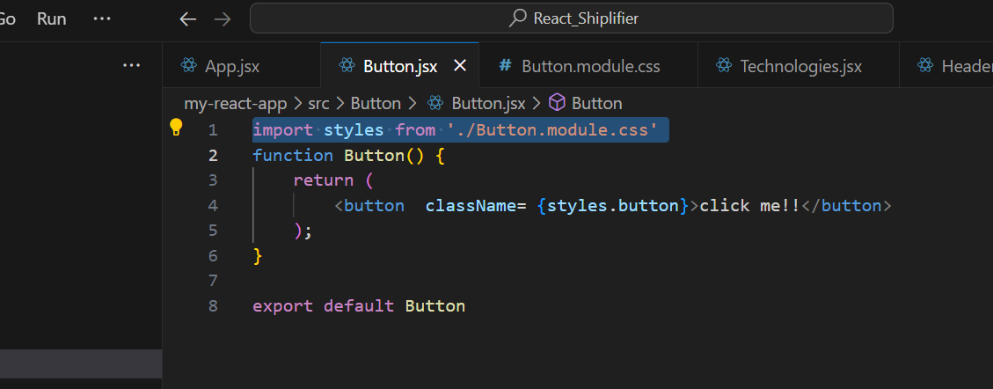
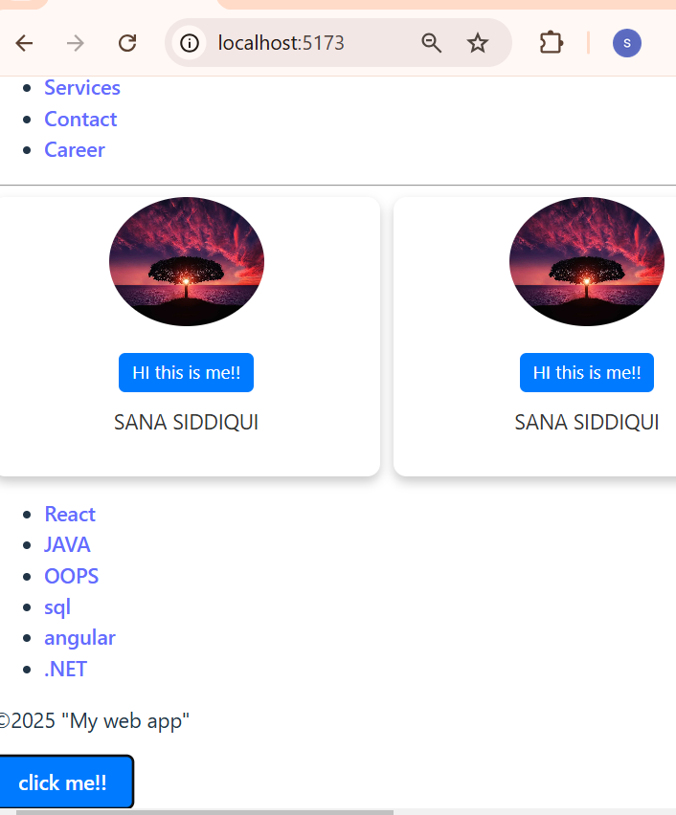
adding css to the module which will import style in jsx file

Slide 18
When adding css in same jsx file then it is styling react component INLINE

Slide 19
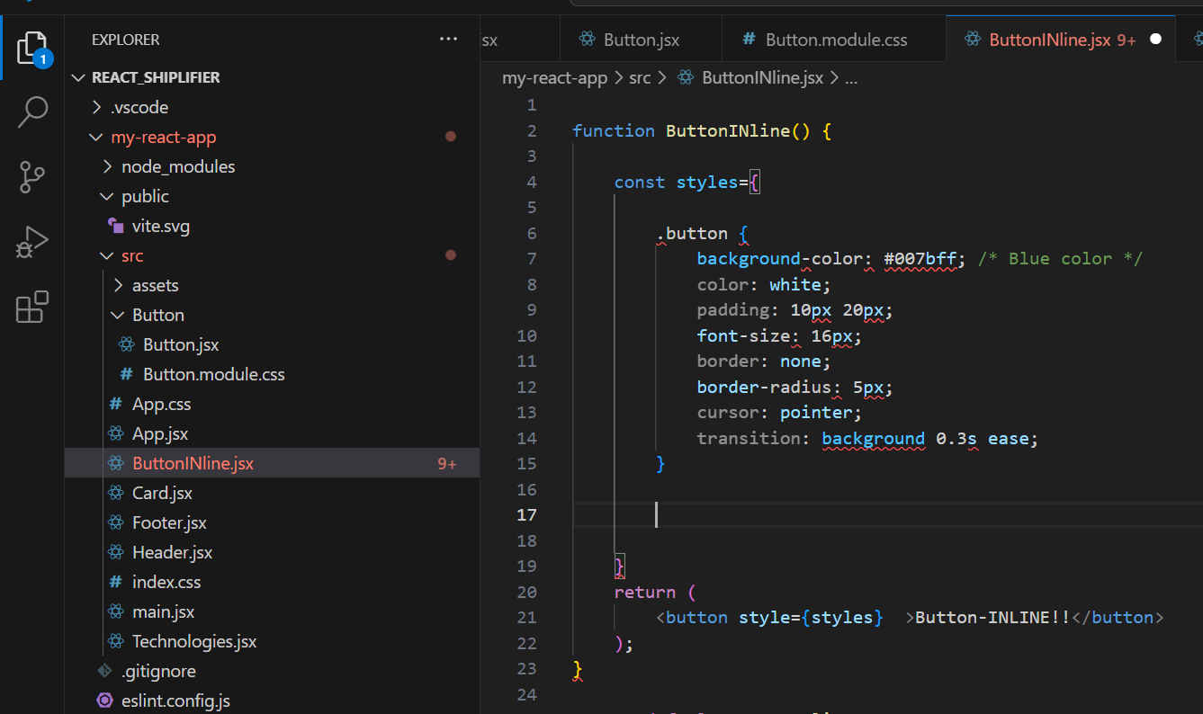
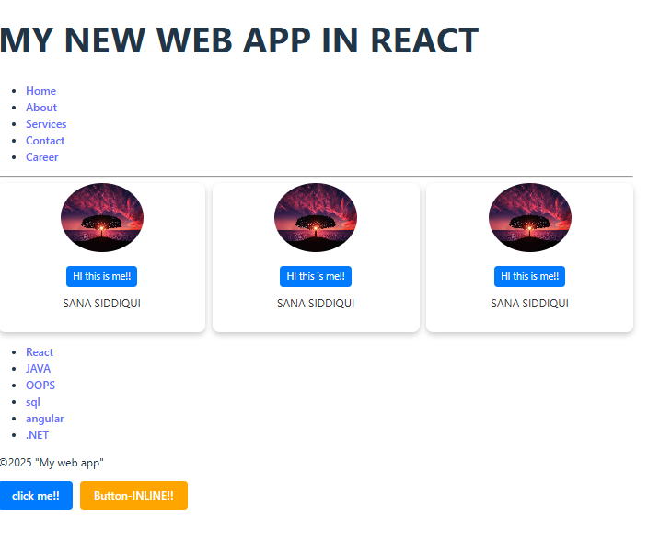
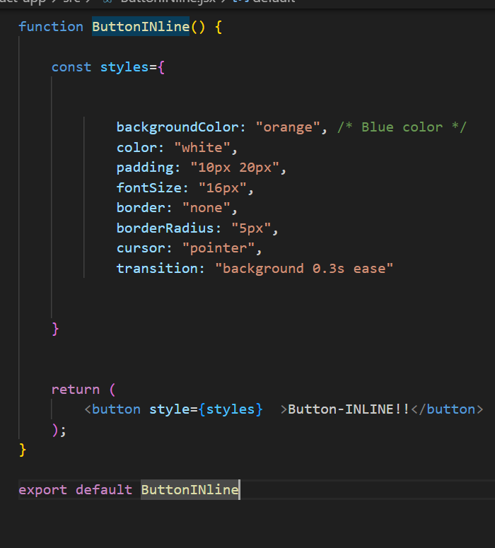
Styling need to follow some Naming conventions as it is in js

Slide 20
Properties---(Props) read only prop shared between components
A parent component can send data to a child component.
<Component key=value />

Slide 21
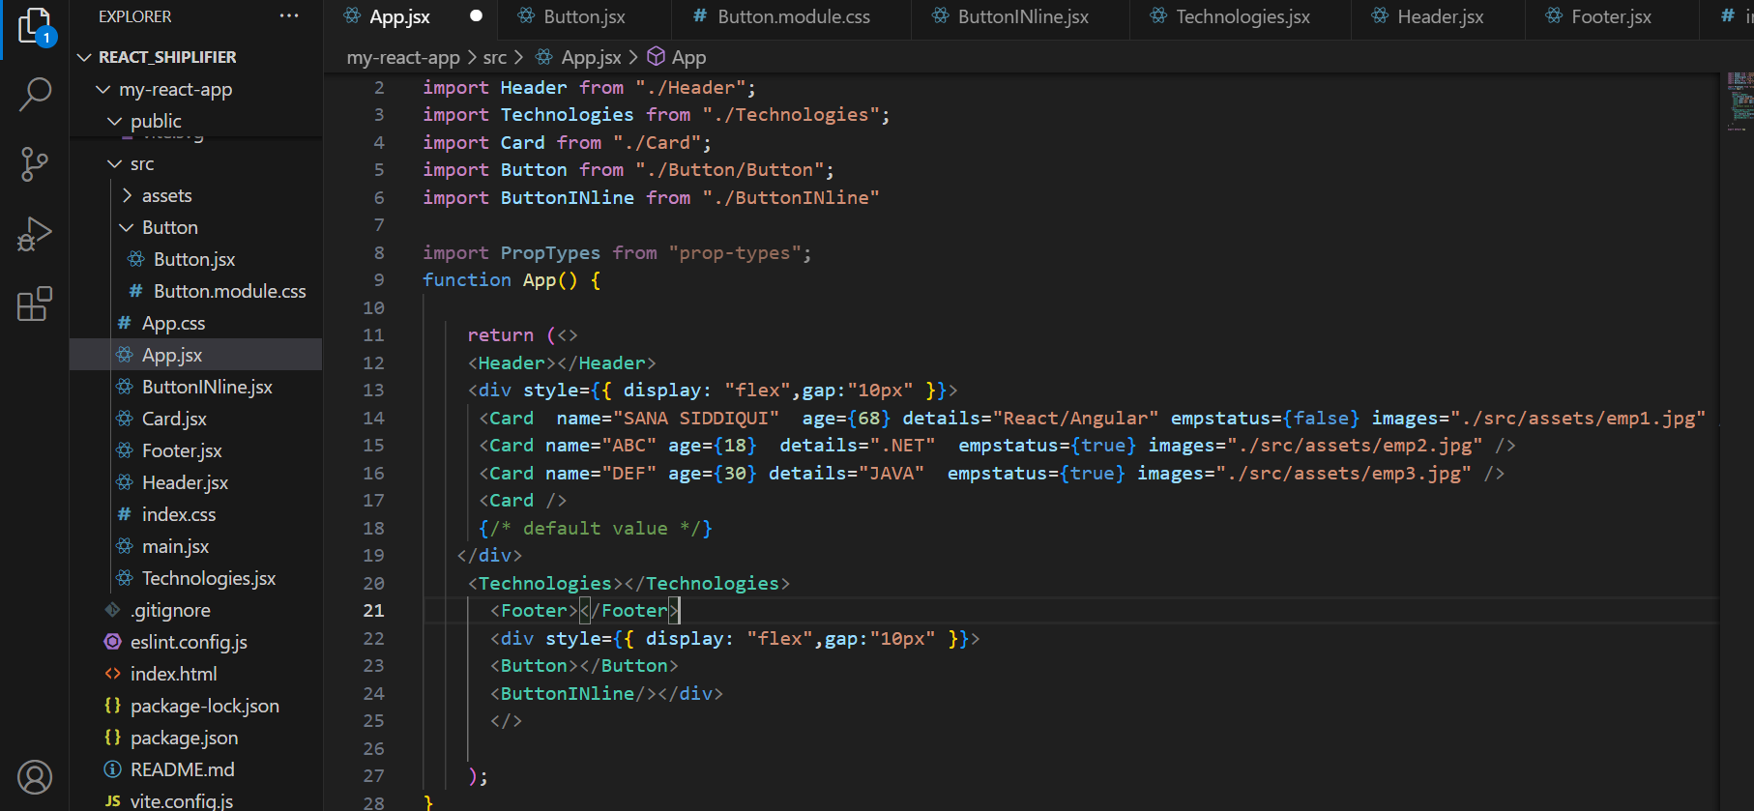
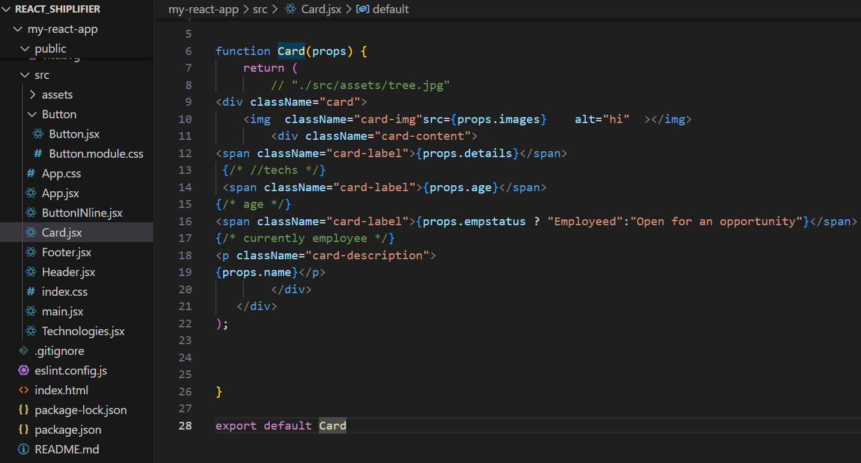

Slide 22
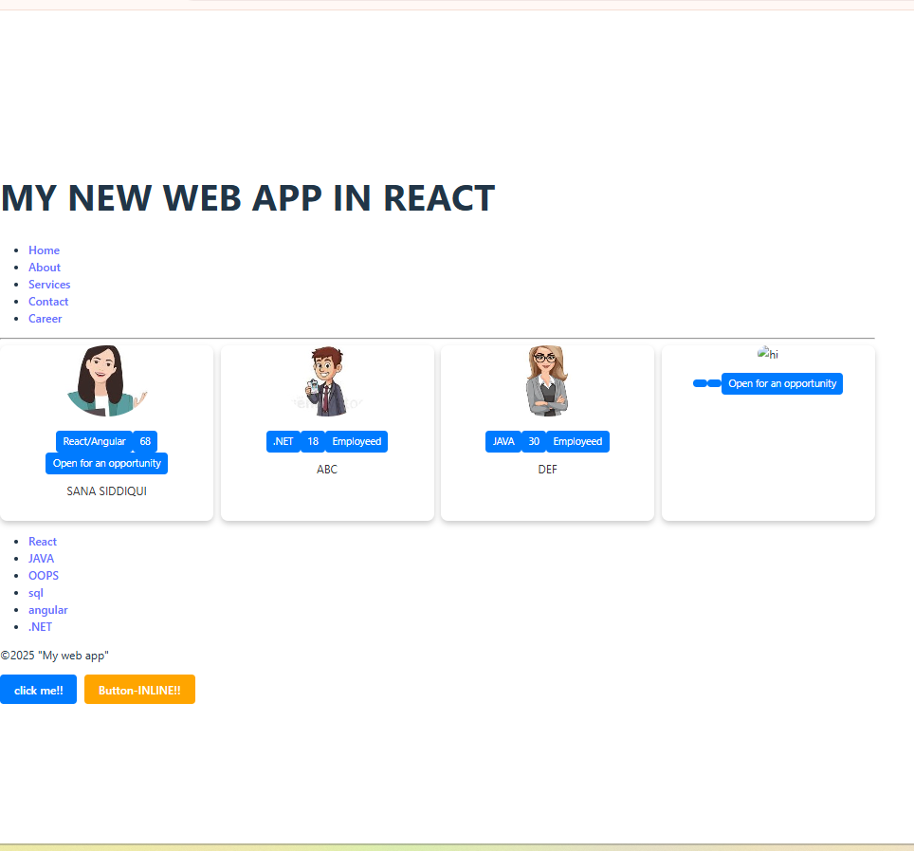

Slide 23
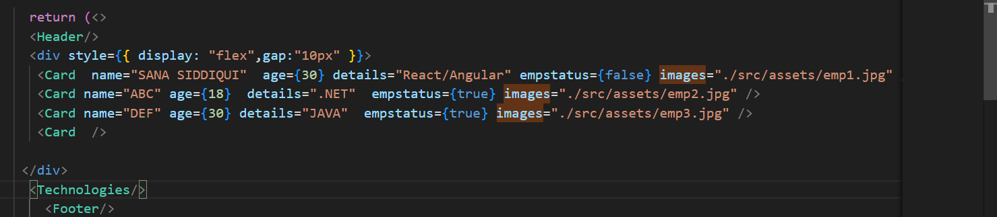
Properties---(Props) read only prop shared between components
now for undefined values mentioned with no data in app.jsx react should be "react": "^18.0.0", "react-dom": "^18.0.0"

Slide 24
import PropTypes from "prop-types"; function Card(props) { return ( // "./src/assets/tree.jpg" <div className="card"> <img className="card-img"src={props.images} alt="hi" ></img> <div className="card-content"> <span className="card-label">{props.details}</span> {/* //techs */} <span className="card-label">{props.age}</span> {/* age */} <span className="card-label">{props.empstatus ? "Employeed":"Open for an opportunity"}</span> {/* currently employee */} <p className="card-description"> {props.name}</p> </div> </div> ); } | {/* for checking the values validation */} Card.propTypes={ images:PropTypes.string, details:PropTypes.string, age:PropTypes.number, empstatus:PropTypes.bool, name:PropTypes.string, } {/* default value */} Card.defaultProps={ images:"./src/assets/tree.jpg", details:"no tech mentioned", age:0, empstatus:false, name:"Guest", } export default Card

Slide 25
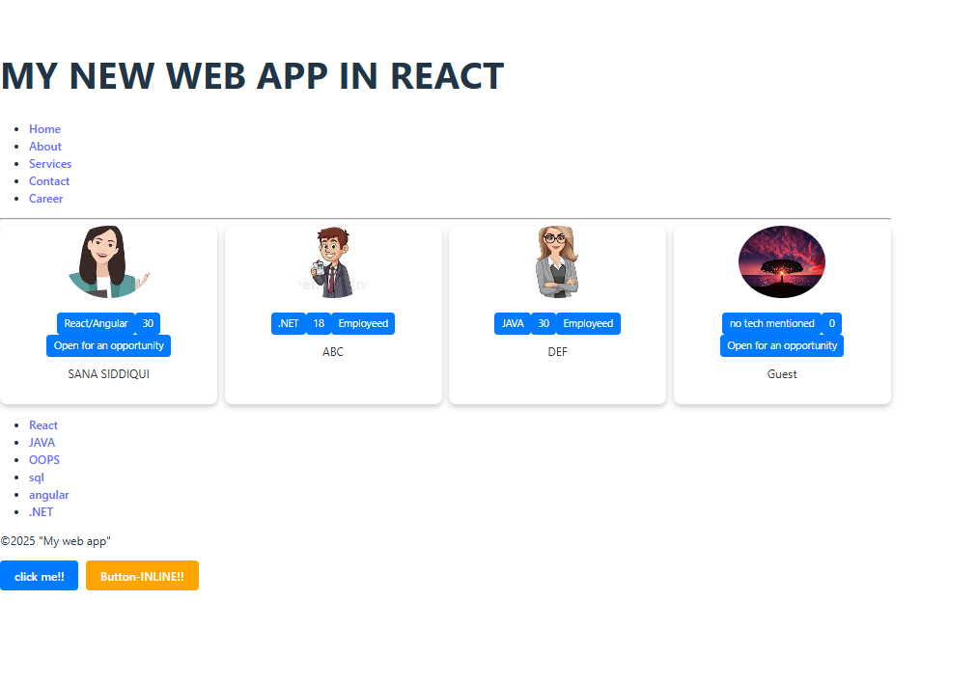

Slide 26
Reusable Components
will use map/filter/sort/ for cards with same values stored in two arrays
-existing employees and
-Companies

Slide 27
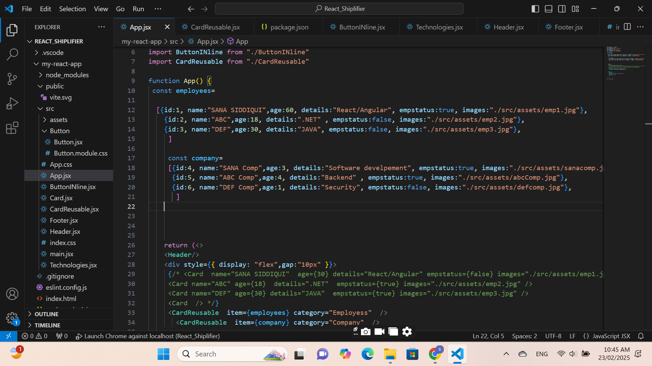
add new array of objects

Slide 28
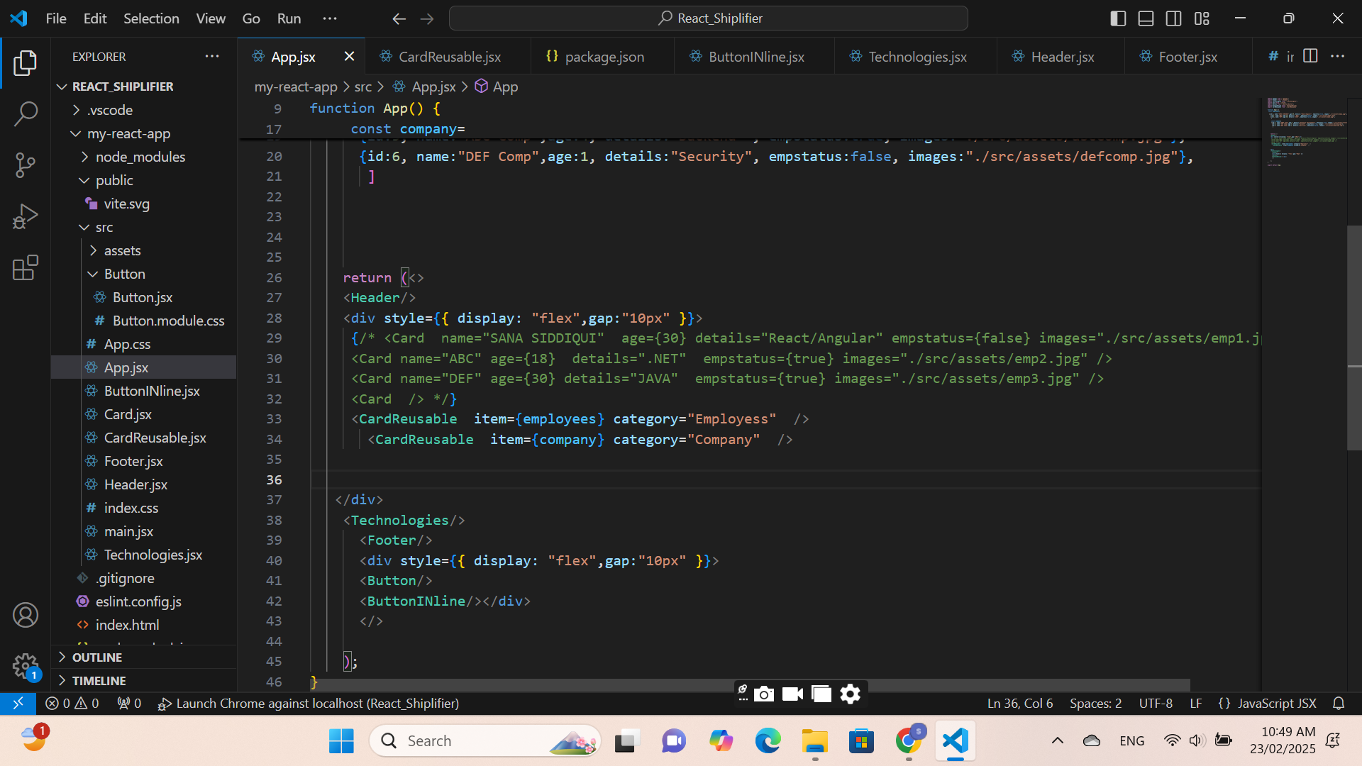
add CardReusable Components with 2 parameters as item and category

Slide 29
add CardReusable Components with 2 parameters as item and category
function CardReusable(props) { const category=props.category; const items=props.item return ( <div className="card"> <h3>{category}</h3> <ol> {items.map(item=> <div key={item.id}> <img className="card-img"src={item.images} alt="hi" ></img> <div className="card-content"> <span className="card-label">{item.details}</span> {/* //techs */} <span className="card-label">{item.age+" "+"years"} </span> {/* age */} <span className="card-label">{item.empstatus ? "Employeed":"Open for an opportunity"}</span> {/* currently employee */} <p className="card-description"> {item.name}</p> </div> </div> )} </ol> </div> ); } export default CardReusable | for getting those two param from main app to reusable components which currently have 2 categories and 3 entries for each category now items have 3 objects for employee and company which is to be mapped in basis of id working as a for loop images for each employees for category employee images for each company for category company details for each employees for category employee details for each company for category company age for each employees for category employee age each companyfor category company --same for these

Slide 30
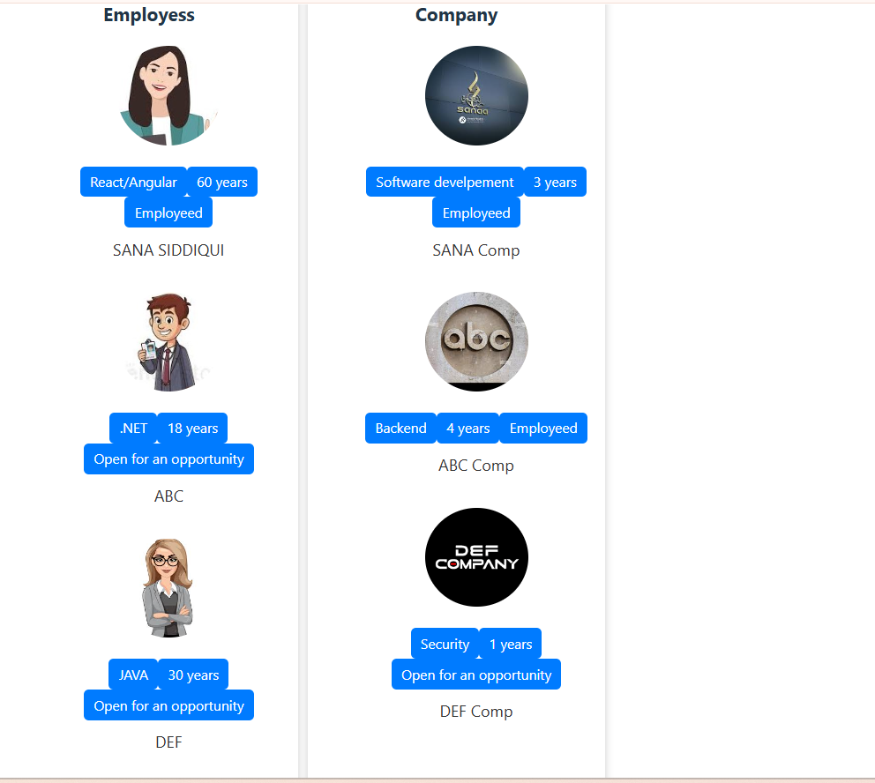

Slide 31
ClickEvent Handling with arrow function onClick={}
onDoubleClick={}

Slide 32
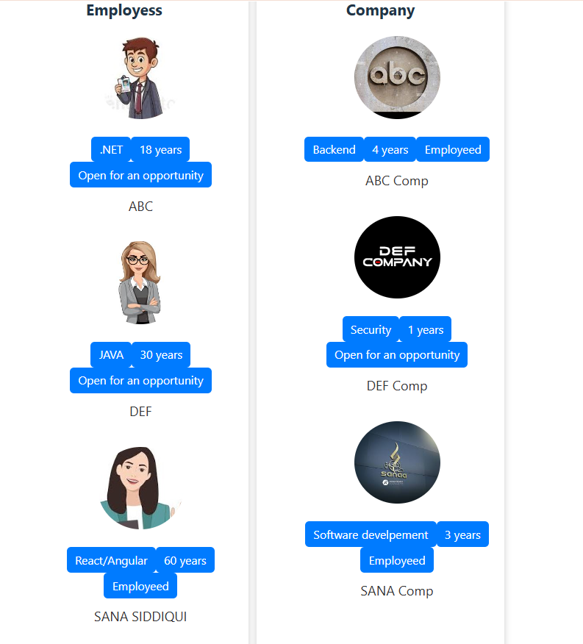
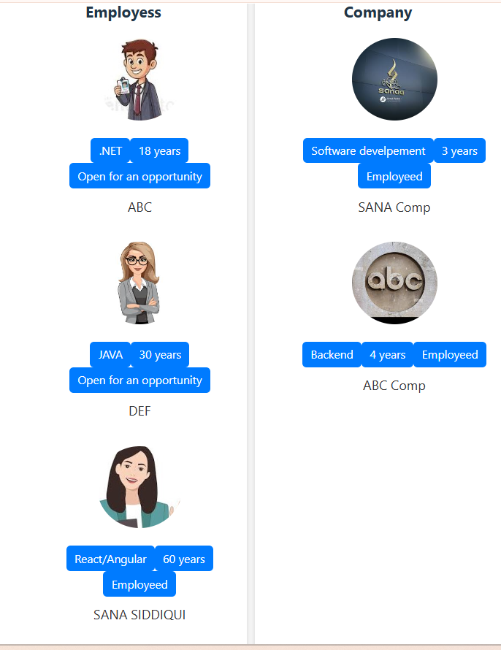
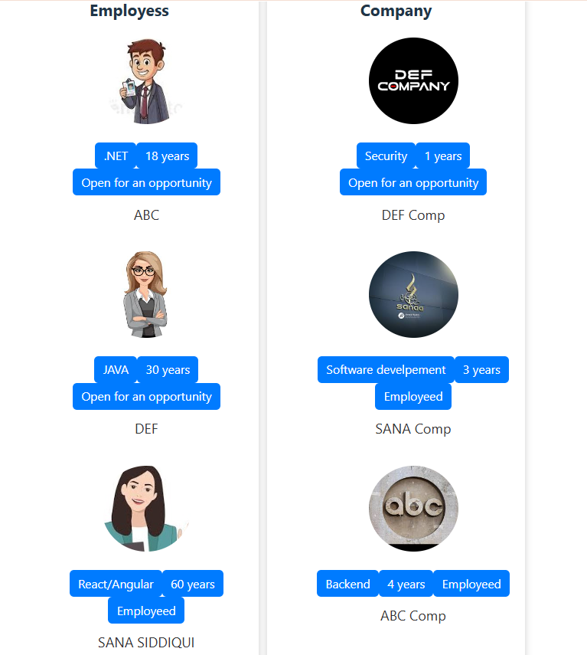
add CardReusable Components with 2 parameters as item and category
 | details for each employe age for each employees for --same for these
const items=props.item.sort((a,b)=>a.name.localeCompare(b.name))
const items=props.item.filter(item=>item.age>2)
const items=props.item.sort((a,b)=>a.age-b.age)

Slide 33
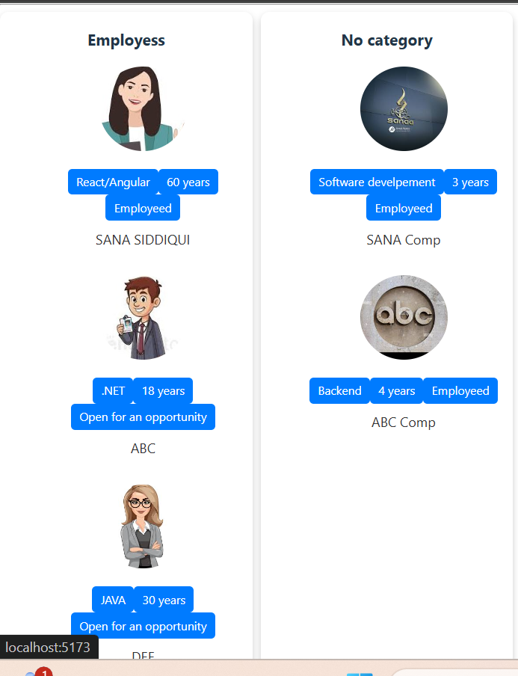
add CardReusable Components with 2 parameters as item and category
CardReusable.defaultProps={
category:"No category",
items:[]
}
CardReusable.propTypes={
category:PropTypes.string,
items:PropTypes.arrayOf(PropTypes.shape({
images:PropTypes.string,
details:PropTypes.string,
age:PropTypes.number,
empstatus:PropTypes.bool,
name:PropTypes.string,}))
}

Slide 34
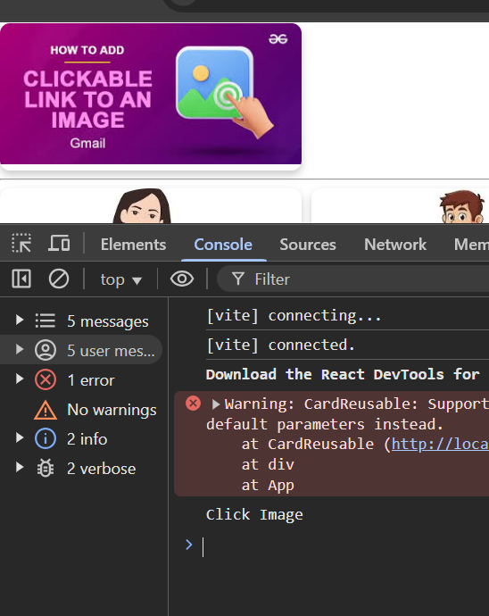
Onclick on a card with image
function Clickable() { const handleclick = ()=>console.log("Click Image") return (<div className="card"> <img className="card-img" src= "./src/assets/clickable.jpg" alt="hi" onClick={handleclick} style={{borderRadius:"0%" ,width:"100%",height:"100%"}} ></img> </div> ); } export default Clickable | function called without parameters OnClick() is called an arrow without parameter

Slide 35
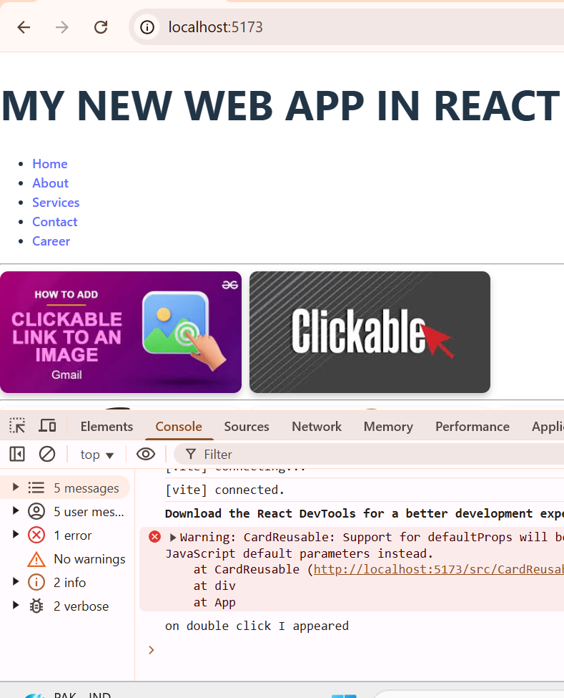
OnDoubleClick event on a card with image
function Clickable() { const handleclick = ()=>console.log("Click Image") const handleclick2 = (data)=>console.log(data) return ( <div style={{display:"flex",gap:"10px"}}> <div className="card"> <img className="card-img" src= "./src/assets/clickable.jpg" alt="hi" onClick={handleclick} style={{borderRadius:"0%" ,width:"100%",height:"100%"}} ></img> </div> <div className="card"> <img className="card-img" src= "./src/assets/clickable2.jpg" alt="hi" onDoubleClick={()=>handleclick2("on double click I appeared")} style={{borderRadius:"0%" ,width:"100%",height:"100%"}} ></img> </div> </div> ); } export default Clickable | function called with parameter onDoubleClick() is called an arrow without parameter

Slide 36
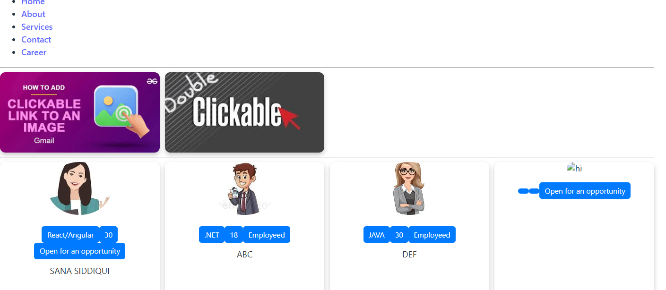
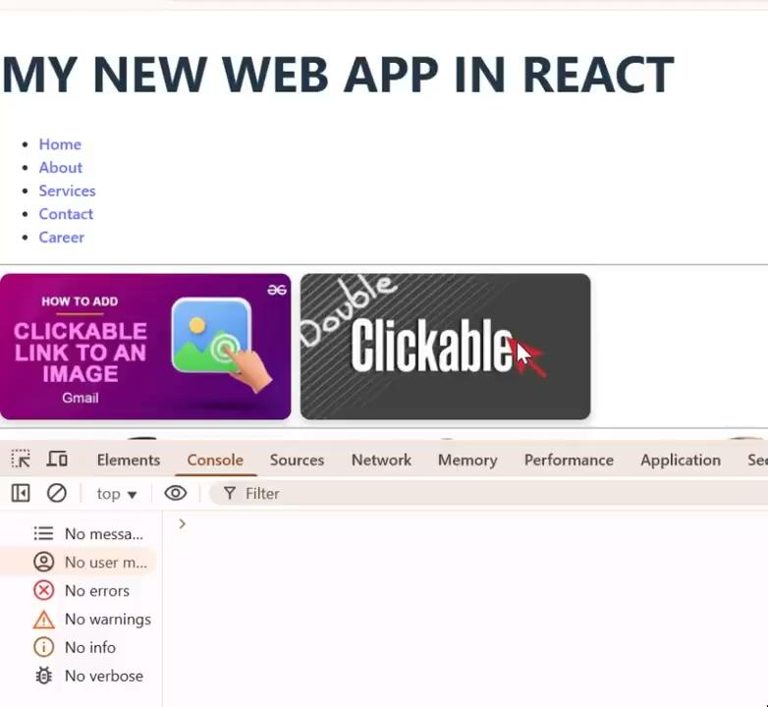
OnDoubleclick on a card with image
function Clickable() { const handleclick = ()=>console.log("Click Image") // const handleclick2 = (data)=>console.log(data) const handleclick2 = (event)=> { console.log(event) event.target.src = event.target.src.includes("clickable.jpg") ? "./src/assets/clickable2.jpg" : "./src/assets/clickable.jpg";} return ( <div style={{display:"flex",gap:"10px"}}> <div className="card"> <img className="card-img" src= "./src/assets/clickable.jpg" alt="hi" onClick={handleclick} style={{borderRadius:"0%" ,width:"100%",height:"100%"}} ></img> </div> <div className="card"> <img className="card-img" src= "./src/assets/clickable2.jpg" alt="hi" onDoubleClick={(e)=>handleclick2(e)} style={{borderRadius:"0%" ,width:"100%",height:"100%"}} ></img> </div> </div> ); } export default Clickable | function called with parameters onDoubleClick() is called an arrow with parameter

Slide 37
Hooks allows functional component to use React features without writing components
USESTATE-- to statore a stateful variable and setter function to update
const [num,setNum()]=usestate(0)

Slide 38
OnDoubleClick event on a card with image
import React, { useState } from "react"; function UseState(props) { const items=props.item props.item.forEach((item, index) => { // item.click = `Click ${index + 1}`; // This will set "Click 1", "Click 2", etc. item.click = index + 1 }); const category=props.category const data=[] for(let i=0;i<props.item.length;i++) data.push({category:props.category,items:props.item[i]}) console.log('data.push({category:props.category,items:props.item[i]})',data) const defaultV = { category: "No category", item: { name: "new", details: "no details", age: 0, empstatus: true, images: "./src/assets/guest1.jpg", click:0 } }; // Assign item[0] let[changingProps, changeProp ]=useState(defaultV) debugger; // const changedProp = () => { // changeProp({ // category: data[0].category, // item: [data[0].items[0], ...data[0].items.slice(1)] // Insert at 0th index // }); // }; const changedProp = () => { debugger; let temp=0,temp2=data.length if(changingProps.item.click>=temp2) changingProps.item.click=0 else if(changingProps.item.click==0) changingProps.item.click=changingProps.item.click temp=changingProps.item.click changeProp({ category: data[temp].category, item: data[temp].items }); if(changingProps.item.click<temp) changingProps.item.click=changingProps.item.click+1 else if(changingProps.item.click==temp) changingProps.item.click=0 }; console.log('changingProps,data',changingProps,data) return ( <div style={{display:"flex",gap:"10px"}}> <h3>UseState hook</h3> <div className="card"> <img className="card-img" src={ changingProps.item.images} alt="hi" onClick={changedProp} style={{borderRadius:"0%" ,width:"70%",height:"80%"}} ></img> <div className="card-content"> <span className="card-label">{changingProps.item.details}</span> {/* //techs */} <span className="card-label">{changingProps.item.age}</span> {/* age */} <span className="card-label">{changingProps.item.empstatus ? "Employeed":"Open for an opportunity"}</span> {/* currently employee */} <p className="card-description"> {props.name}</p> </div> </div> </div> ); } export default UseState | to import the react library added a new column to use useState hook to display all employees data on one card by clicking const data=[] ti push all pops data in it as an object

